Slide 1

Twitter sentimental analysis
-Avi Chaudhary

Slide 2

Content
Introduction
Problem statement
Objective
Software And Hardware Requirement
Textblob Implementation
Cleaning the text
Word cloud
Conclusion
Future Work

Slide 3

Problem statement
The problem in sentiment analysis is classifying the polarity of a given text at the document, sentence, or/aspect level.
Whether the expressed opinion in a document, a sentence or an entity feature/aspect is positive, negative , or neutral.

Slide 4
Introduction
Sentiment Analysis-NPL tool, tracks public mood, specific product or service.
Analyze huge data, construct system, gather-analyze review, certain product
Why Twitter:
Micro-blogging system, send and receive short posts(tweets).
Increasingly popular-Academics, Students, Policymakers, Politicians and General Public
It allows-Easy Promotion Reach large people- tweets and retweets, follow work – Field Experts and New audience.
Twitter-individually biased, No concrete decision.
Tweets filtration, comparative analysis

Slide 5

Software requirements
Jupyter -
Jupyter notebooks provide an interactive computational environment for developing data science applications. Jupyter notebooks combine software code, computational output, explanatory text, and rich content in a single document.
Google colab -
Open source web application – create and share document – live code, equations, visualization, narrative text.
Python -
High level general purpose programming language, latest version 3.7.4 .
A twitter developer account -
Access twitter API , sign up for Twitter developer account, app create steps. After approval , save four keys - consumer key, consumer secret key, Access Token, Access Secret.

Slide 6
Library Requirements (in python)
TextBlob
Word cloud
Python library –processing textual data, consistent API, common natural language(NLP) tasks –POS tagging, noun phrase extraction, sentiment analysis, and more
Open source python package – convenient access – Plot words in a frame on the basis of no. of time the word has been used in the given input.
Tweepy
Open source Python package – convenient access – Twitter API with Python. Includes- methods and classes – represent Twitter’s models and API endpoints, transparently handles implmentaion details.

Slide 7
objective
TextBlob –Tweet analysis.
We filter tweets –comparative analysis, judgement of situation- more accurately
Finding polarity of text we analyze-public opinions , product or service
We used a Twitter API to extract tweets.
We connected twitter backend –twitter developer account.
Twitter
Tweets
Main objective
Most common platform, convenient source, regularly updated
Biased, individual opinions, impossible access all tweets, solid decision.
Analyze and predict the sentiment of each tweet.

Slide 8

Cleaning the text
What a run. @serenawilliams will be leaving behind an extraordinary tennis career that challenged the double standard between male and female players. I look forward to watching her continue building her amazing legacy off the court #sports. https://t.co/K9Hxa2jB3I
#sports
What a run. will be leaving behind an extraordinary tennis career that challenged the double standard between male and female players. I look forward to watching her continue building her amazing legacy off the court.

Slide 9
Textblob implementation
objective
tweepy
Access tweets
tools
textblob
tokenization
algorithm
Cleaning the data
testing
Removing the stop words
output
classification

Slide 10
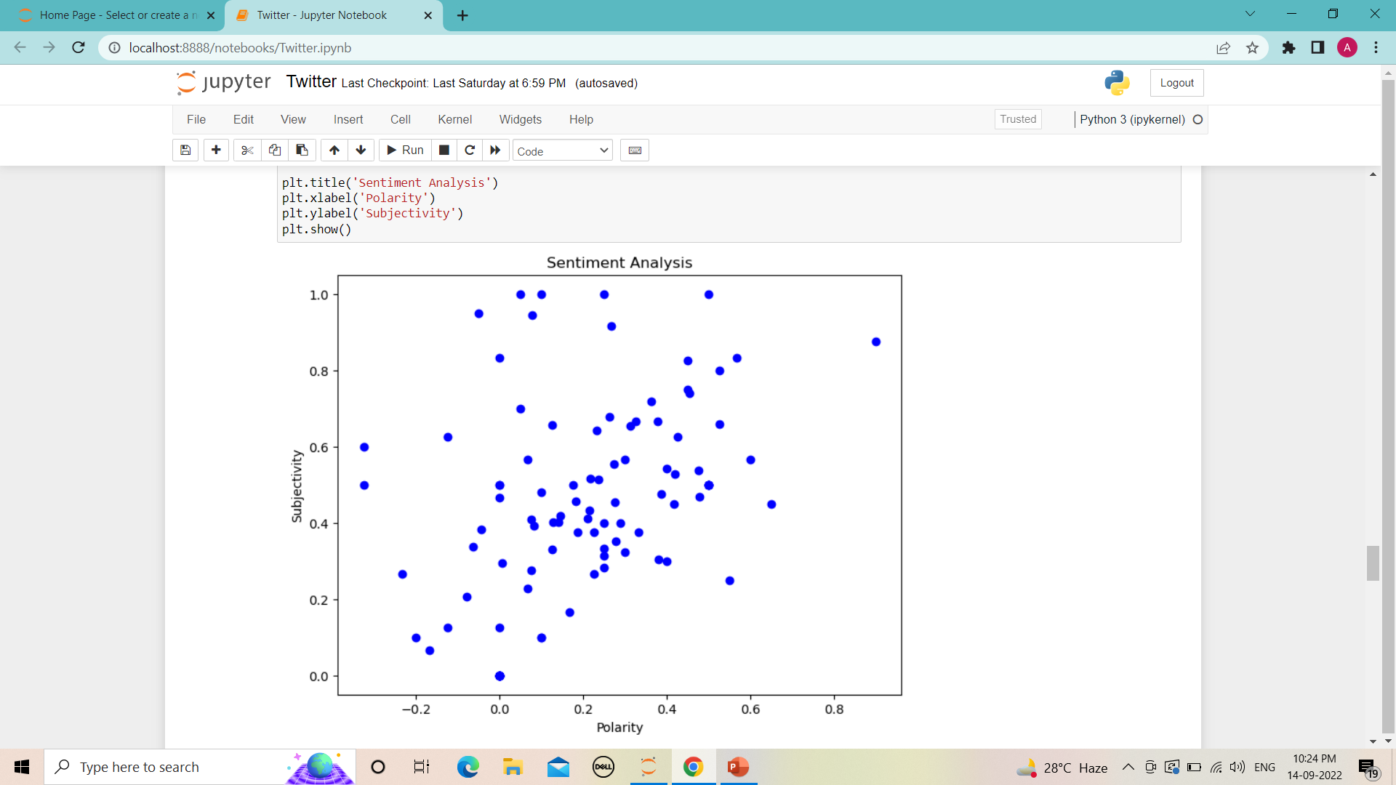
Scatter graph

Slide 11
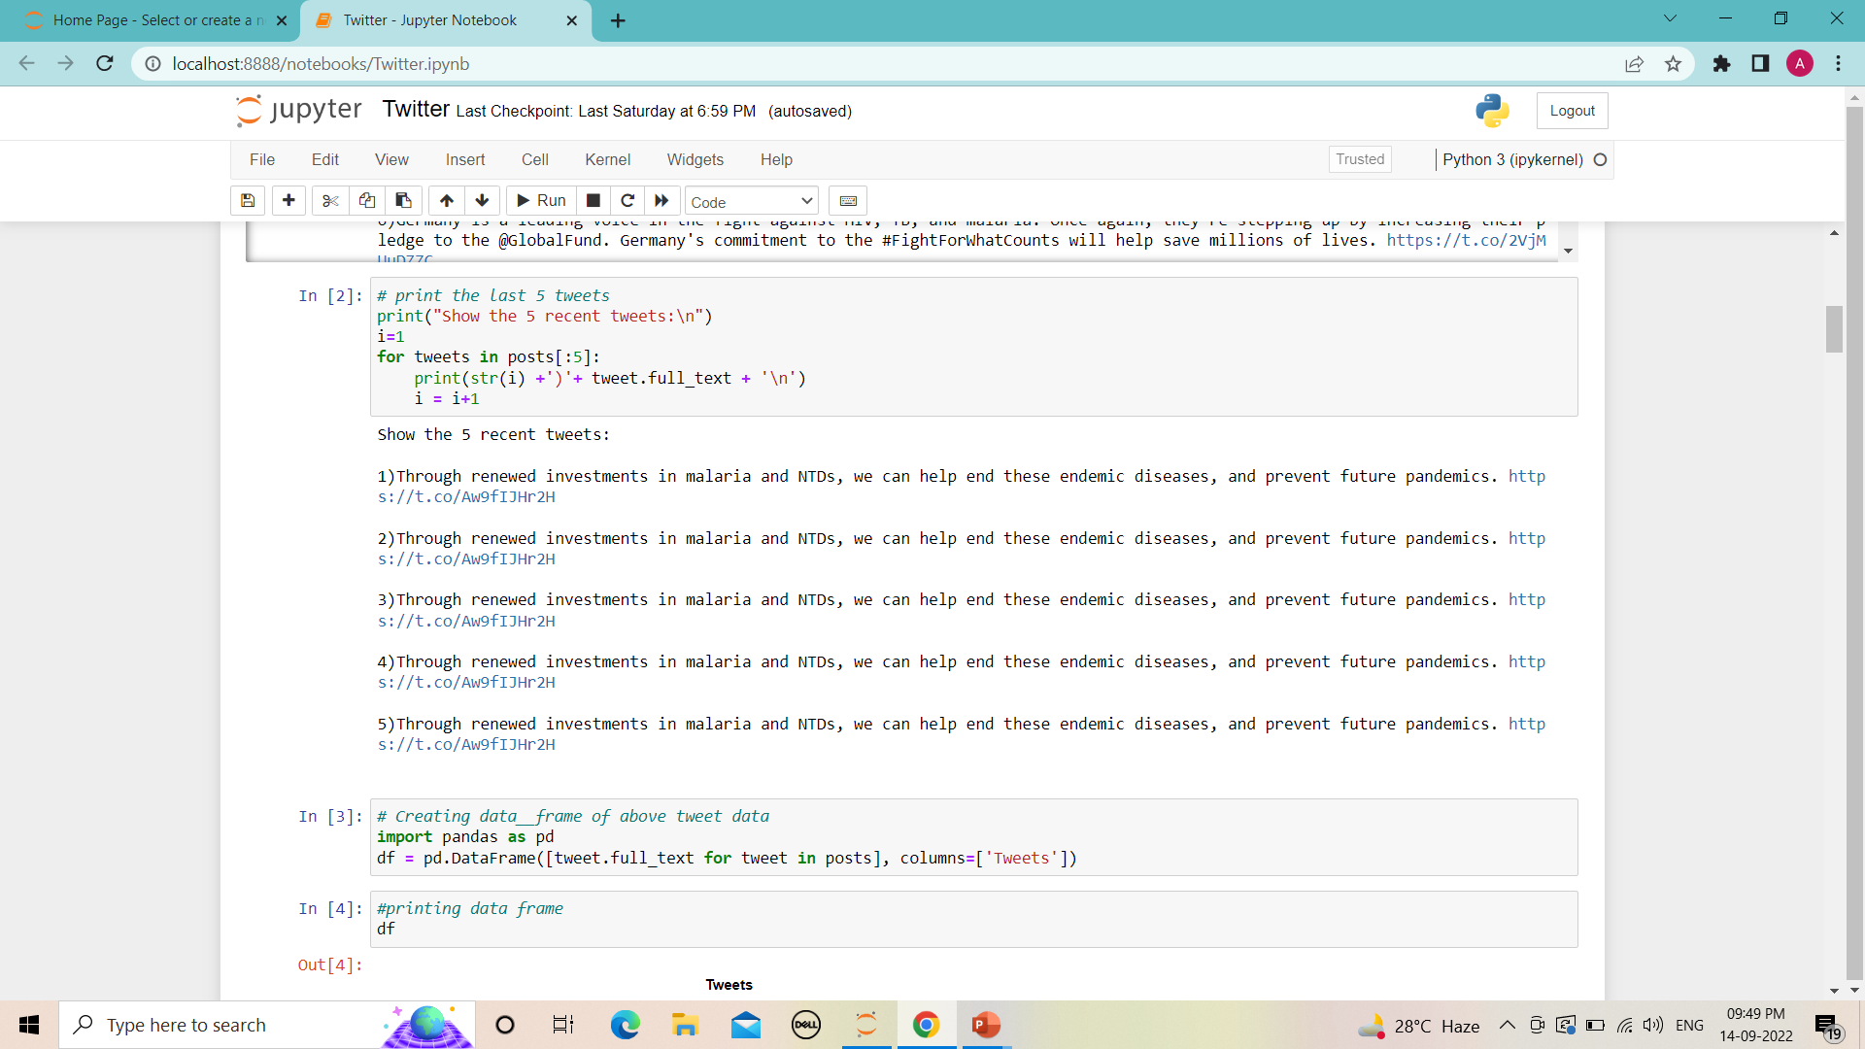
Accessing tweets

Slide 12
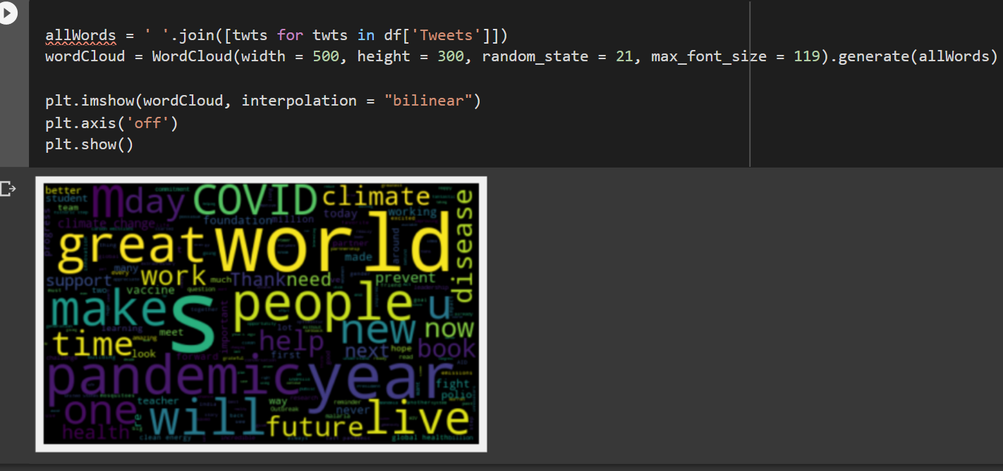
World cloud

Slide 13
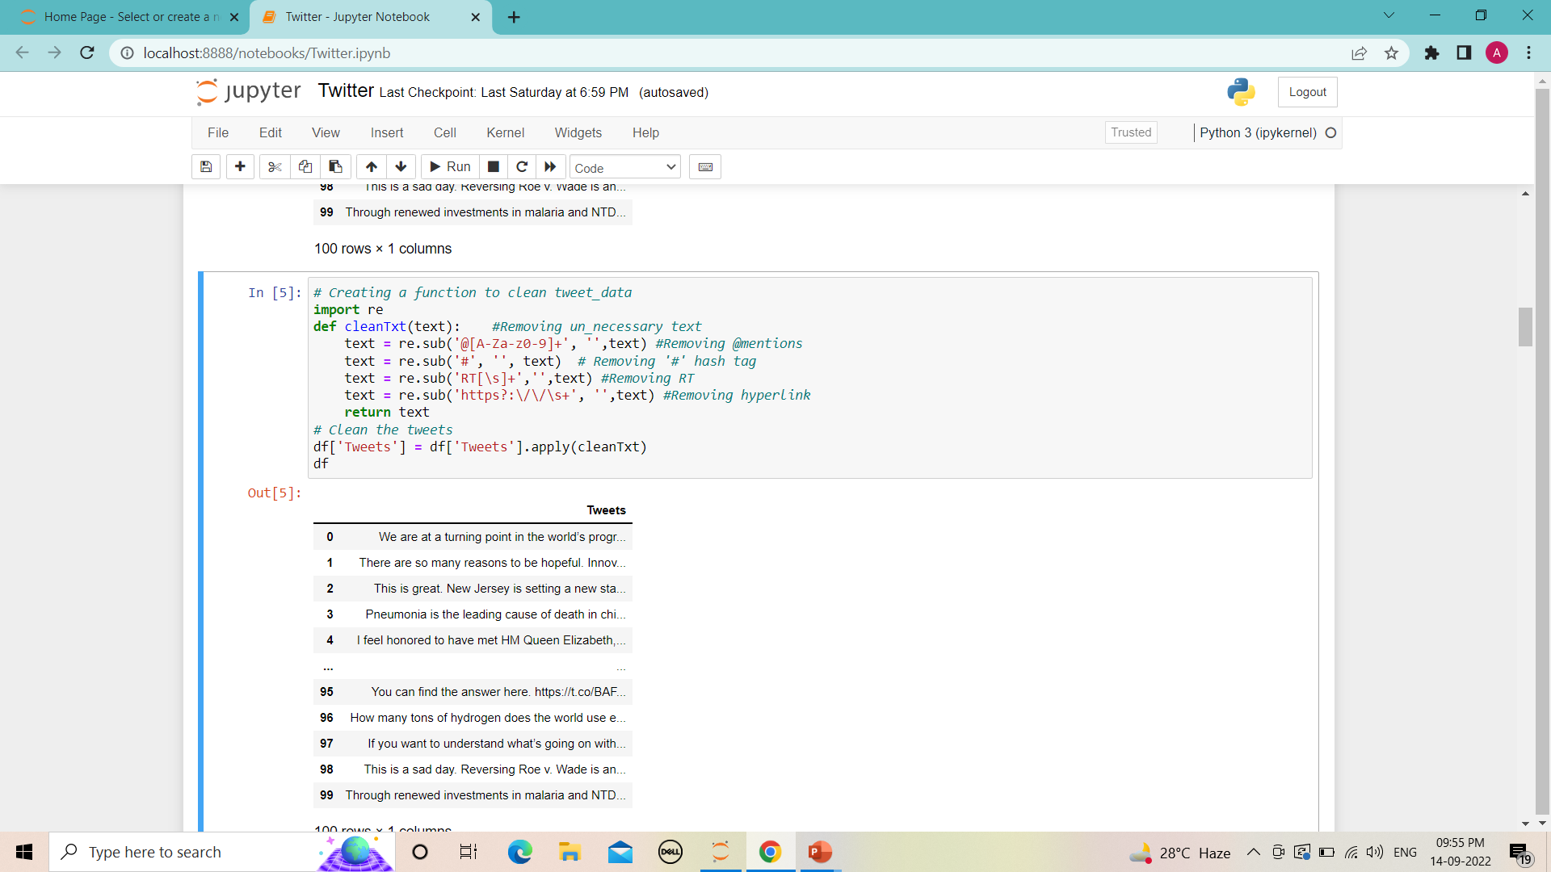
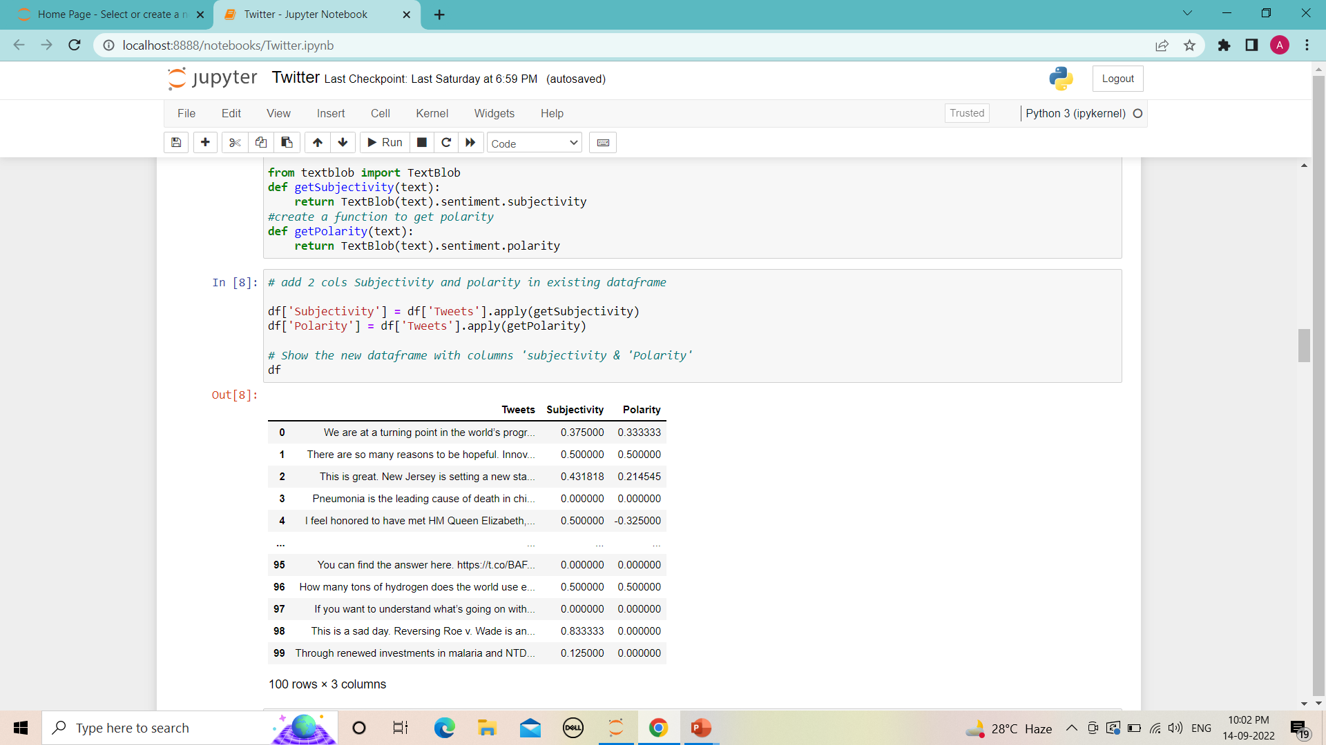
Cleaning the text
Subjectivity and polarity

Slide 14
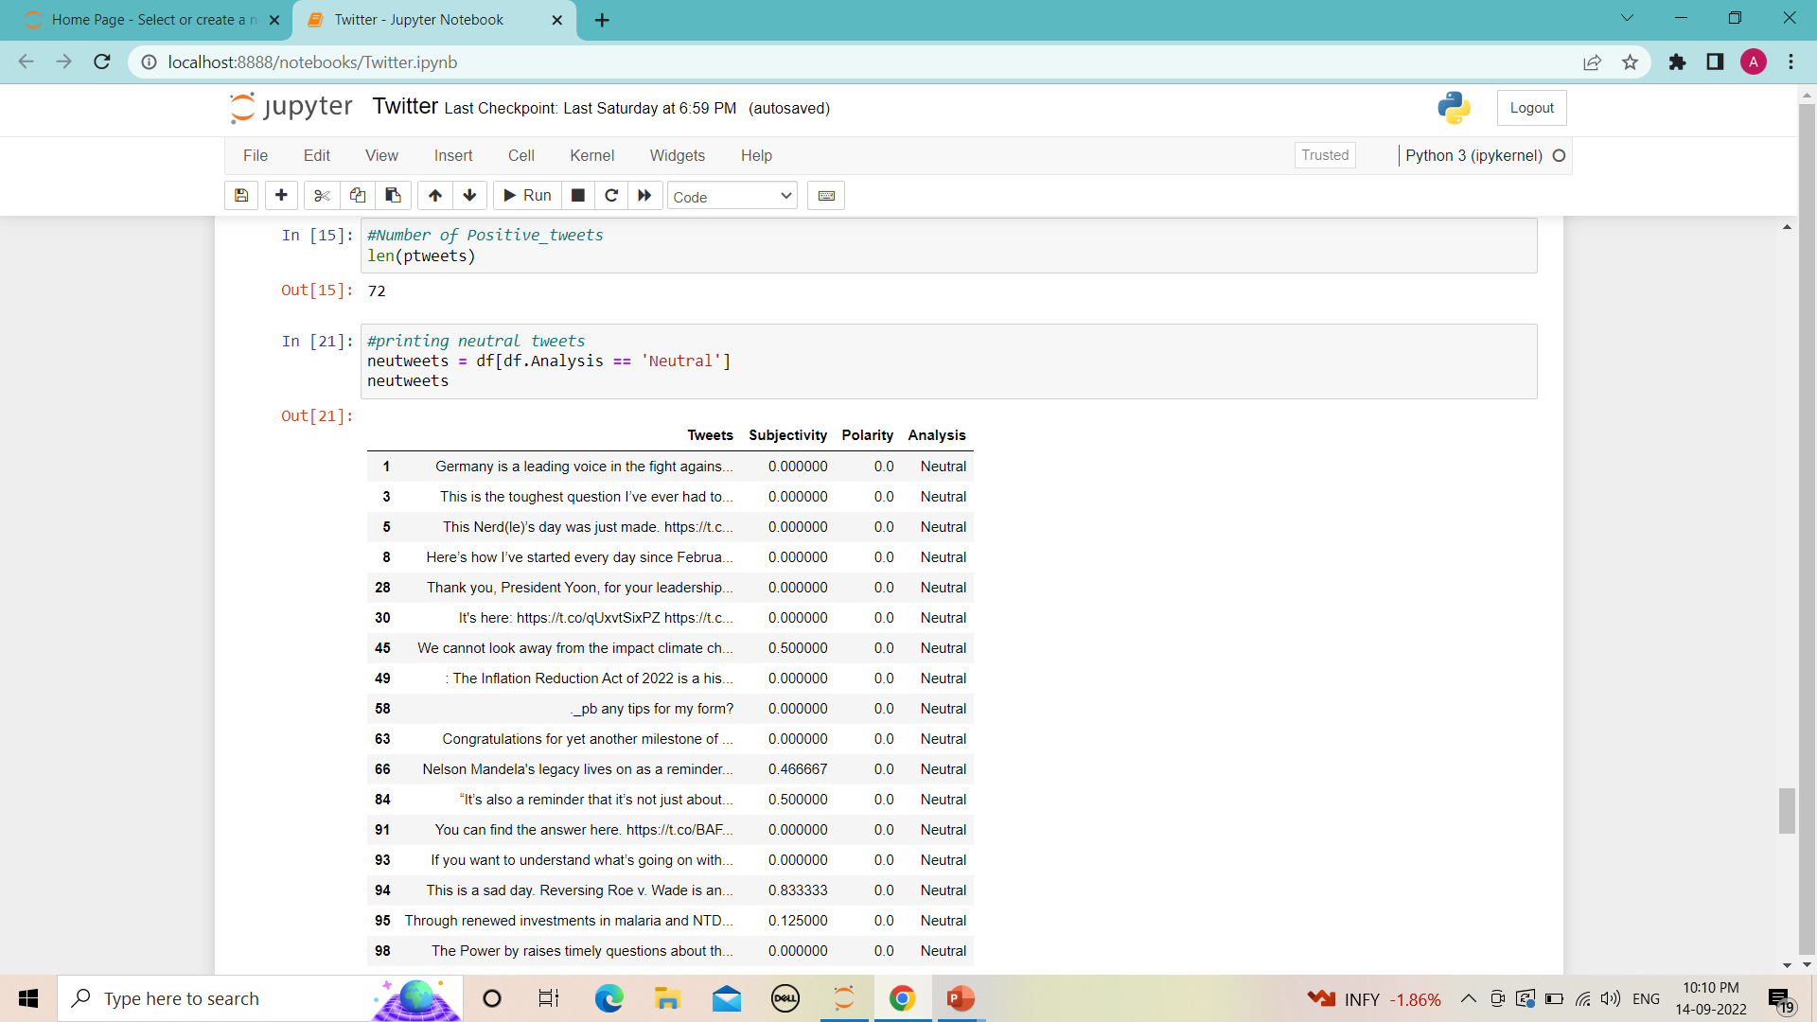
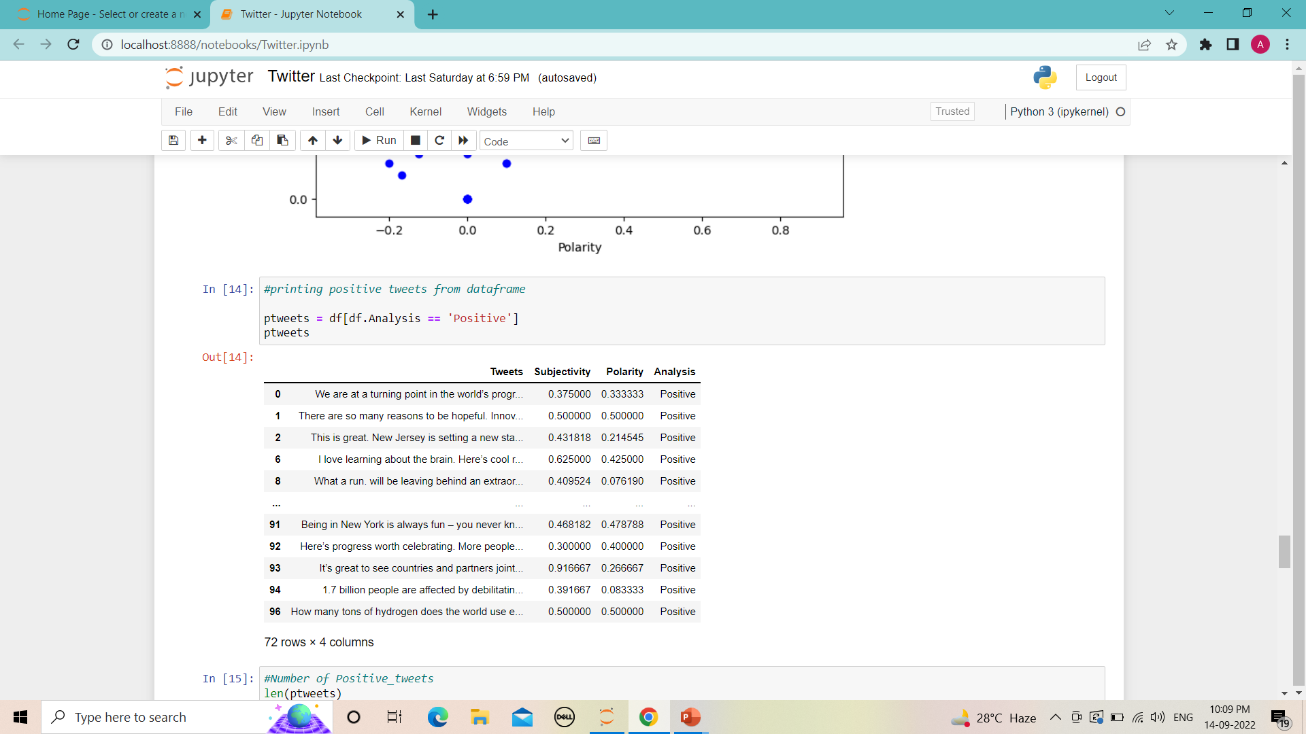
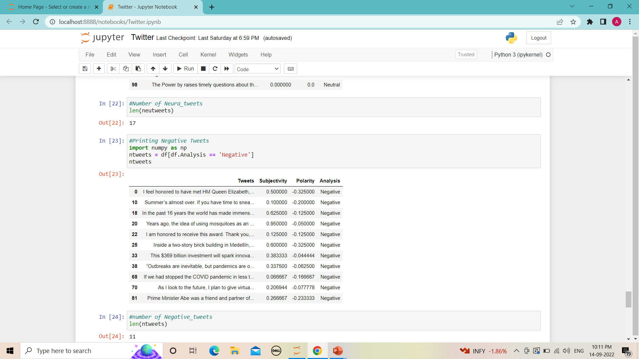
Neutral tweets
Positive tweets
Negative tweets

Slide 15
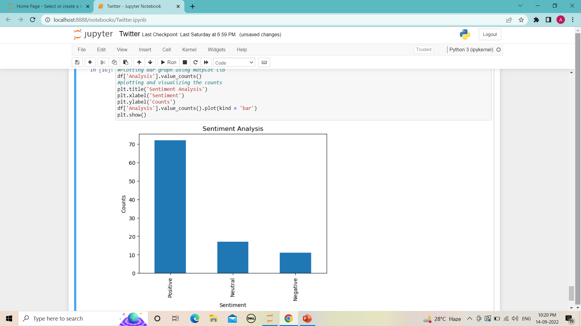
Bar graph

Slide 16

conclusion
Sentiment analysis/ opinion mining –wide area –real time applications, has many research limitations.
Since fast internet growth internet related applications, Sentiment Analysis – most interesting research area
Our project –extracted the real time tweets –we analyzed –sentiments of individual tweets –classify according polarities.
​
Major limitations –Sentiment Analysis:
​
1. Spam and fake reviews detection.
2. Classification Filtering limitation
3. Irony, humor, negations in tweets –sentiment analysis tools –not much effective
4.Very complex –analyzing short texts, limited information.
5. Analyses suitable – English language, limitation- other languages.

Slide 17

Future work
Huge scope – improvement, pre –existing models – opinion mining –
Analyzing sentiment – more sematic and common sense knowledge-
Gives accurate and efficient results.
The main areas for future sentiment analysis are :
Spam Detection Sentiment.
Sentiment Analysis – short sentence , short text.
Improvement – sentiment word identification.
Development – automatic analyzing tool.
Proper Classification – bi polar sentiments.
Better technology – less process time.

Slide 18

Thank you

